Slide 1
GACE | 2021 | GO GACE!

Slide 2
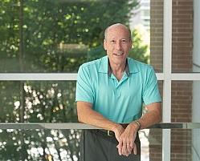
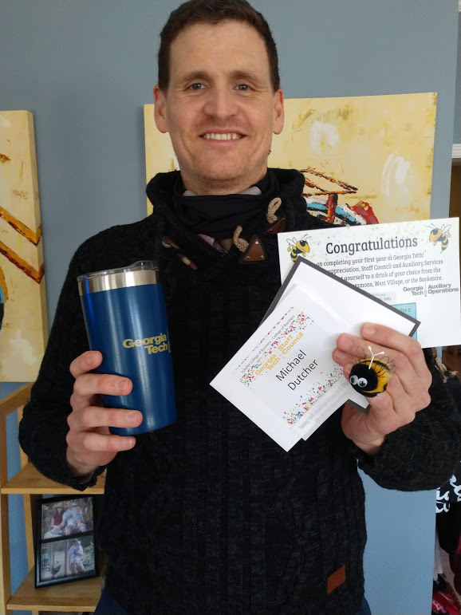
“Upgrade Your Department through Office Habit Improvement” The Scheller College of Business at Georgia Tech
Stan Broome
Michael Dutcher

Slide 3
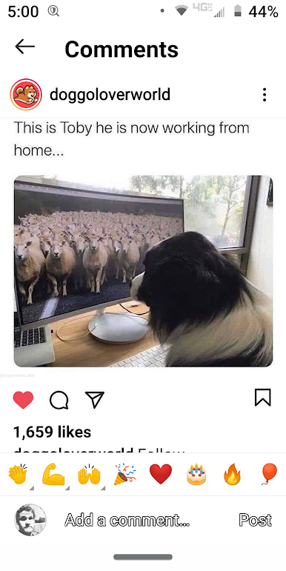
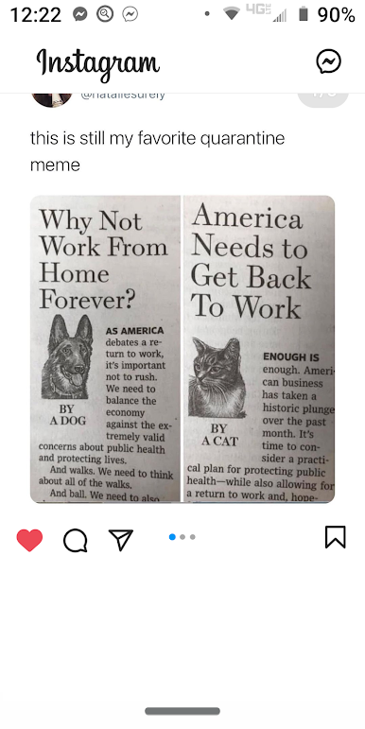
Congratulations! You have survived an intense period of ‘fun times.’ We bet your habits helped. So, what is next?

Slide 4
Poll 1: Who is here today? A – College Member B – Employer Member C – Lifetime or Retired Member D – Vendor

Slide 5
What’s the Scheller Story?
The Strategy that influences our office habits:
Early Engagement
Consistent messaging
Direct services
Faculty buy-in
Alumni follow up
Required Career Class
Results:
Poets & Quants Business School Ranking – 2020:
#1 Career Team
#1 Finding Your Dream Job
#1 Academic Advising Team
#10 Undergraduate Program

Slide 6
One Strategy to Improve Your Office’s Habits:
Habit Levels:
Level 1: Habits that allow us to do what we are asked to do.
Level 2: L1 Habits + Habits that allow us to think ahead and solve problems before they happen.
Level 3: L1 + L2 Habits + Habits that allow us to proactively look for areas of opportunity and growth [in your area of focus] and figure out how to tap into them.
Method Created by James Clear

Slide 7
One Strategy to Improve Your Office’s Habits:
Habit Levels:
L1: Surviving Habits that allow us to do what we are asked to do.
L2: Building L1 Habits + Habits that allow us to think ahead and solve problems before they happen.
L3: Thriving L1 + L2 Habits + Habits that allow us to proactively look for areas of opportunity and growth [in your area of focus] and figure out how to tap into them.
Method Created by James Clear

Slide 8
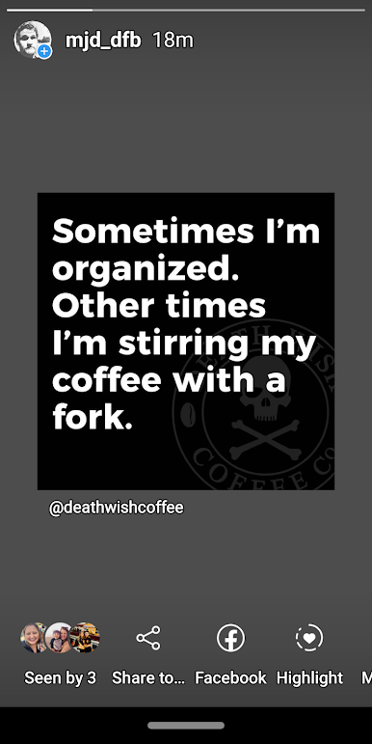
Poll 2: Are your professional habits mostly….? A – Surviving Habits B – Building Habits C – Thriving Habits

Slide 9
Go from Surviving to Building:
Step 1: Identify your L1: Surviving Habits
Think Individual Position | Think Office/Team | Think Organization
Step 2: Pick one of them and identify obstacles & successes
Step 3: Reflect on the lessons learned & build on them to identify the “Building” version of that habit.
Step 4: Repeat.
Scheller Example:
L1: Surviving | Updating all career development content regularly
L2: Building | L1 + Holding yearly employer focus groups to review
career development content and update it.

Slide 10
Go from Building to Thriving: ”Hot shot rule.”
Step 1: Identify your L2: Building Habits: Individual | Office | Organization
Step 2: Apply the “hot shot rule” to each (Thank you Kat Cole) & meet with/study those that you think are thriving.
Step 3: Reflect on the lessons learned and to identify areas of opportunities and create L3: Habits that allow you take advantage of them.
Scheller Example:
L2 Building | L1 + Holding yearly employer focus groups to review
career development content
L3 Thriving | L1 + L2 + Collect best practices from executive interviews
executed by students.

Slide 11
Consider this idea to get started:
Make some lists.
What habits allowed you be successful before the pandemic?
What habits allowed you to be successful during the pandemic?
What habits do you predict will be needed for success in the coming year?
Hint: Switch out “habits” with “skills” if you are struggling with putting your habits into words.

Slide 12
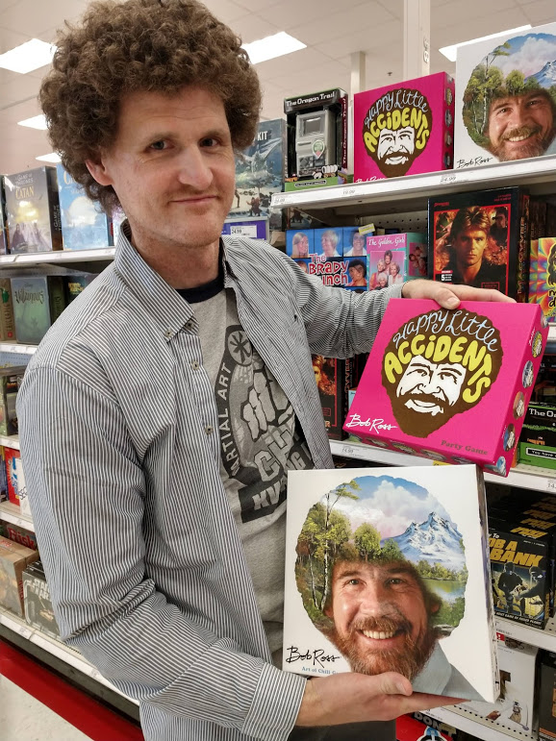
Question & Answer with the Dutcher Fro:
Type your responses into the Q & A to this question:
- List out what habits you predict will be needed for success in the coming year?

Slide 13
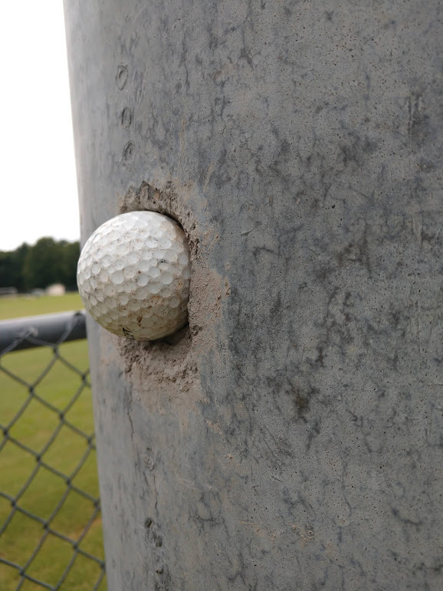
Our Predictions:
Conducting 1 hour of professional development a week
Using constituent data to research industry trends
Converting content/interactions/experiences to updated formats such as: Live in-person, Online Synchronous, Online Asynchronous
Recruitment strategies including onboarding processes for in-person and remote staffers.

Slide 14
In the coming year challenge:
Talk with your colleagues about:
- What habits must continue within your office to be successful?
- What habits must you develop within your office to be successful?
- What will happen in the next recruitment cycle?
- What will happen in the next academic year?
Extra Credit Opportunities:
What programs/practices could you reset in the coming year?
- Focus on previous goals – New ROI targets – Revisit the desired outcomes
What programs/practices would you retire to make room for the next?
- What is replacing them – How much time does it free up within the operations of the office?

Slide 15
Thank You | Go GACE!

